Slide 1
NORTH SOUTH UNIVERSITY
Lecture 14
PHI 104
Introduction to Ethics

Slide 2
Public Governance Ethics
Administrative & Professional

Slide 3
Introduction
Ethics provide accountability between the public and the administration. Adhering to a code of ethics ensures that the public receives what it needs in a fair manner. It also gives the administration guidelines for integrity in their operations. That integrity, in turn, helps foster the trust of the community. By creating this atmosphere of trust, the administration helps the public understand that they are working with their best interests in mind.

Slide 4
Administrative ethics implies applying general moral rules to specific sphere of human relations, that is to say administrative relations. Some of the most important areas of applied ethics today concern the ethics of administration. In spite of the fact that public administration is very old institution, administrative ethics is still undeveloped and it longs for specific moral rules that cover maybe the most important area of human relations – administrative relations. But it is the same with other kinds of applied ethics such as business ethics, medical ethics etc.

Slide 5
Not earlier than twenty years ago it has been started organized and methodical discussion about ethical questions in the work of public administration. For this reason administrative ethics has not been built yet like a particular discipline of applied ethics. There are few law schools in the world which have administrative ethics in their curricula. Ethical themes are most often discussed within the parts of administrative law or philosophy of law.

Slide 6


Slide 7
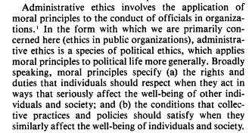

Slide 8
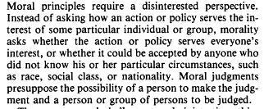

Slide 9
Professional Ethics
Professional ethics is concerned with the values appropriate to certain kinds of occupational activity, such as medicine and law, which have been defined traditionally in terms of a body of knowledge and an ideal of service to the community; and in which individual professionals have a high degree of autonomy in their practice. The class of occupations aiming to achieve recognition as professions has increased to include, for example, nursing, while at the same time social and political developments have led to criticism of and challenge to the concepts of professions and professionalism.

Slide 10
Problems in professional ethics include both regulation of the professional-client relationship and the role and status of professions in society. A central question for ethics is whether there are values or virtues specific to particular professions or whether the standards of ordinary morality are applicable.

Slide 11
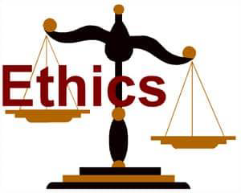

Slide 12
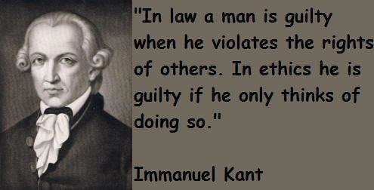

Slide 13
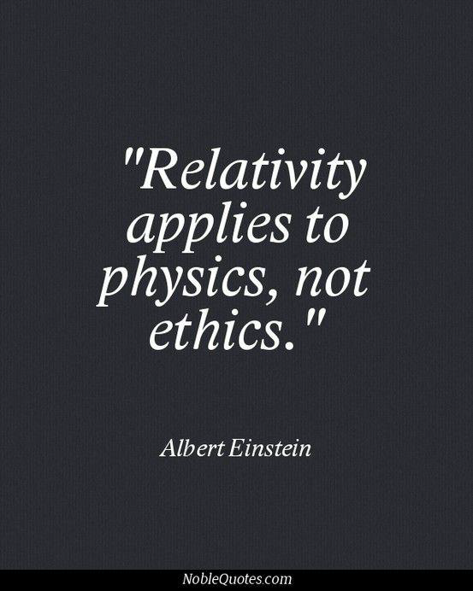

Slide 14


Slide 15
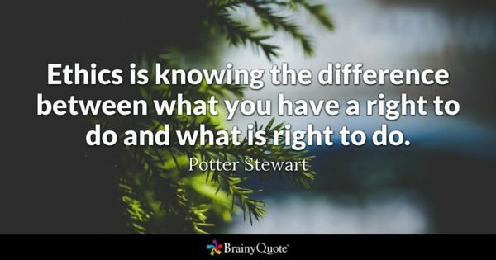

Slide 16
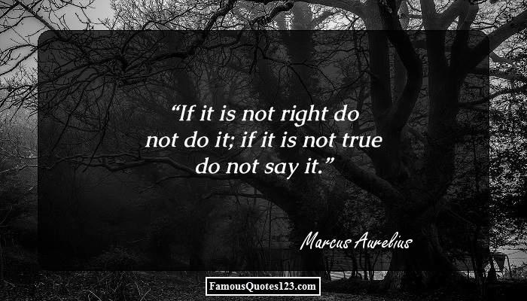

Slide 17
Prelude
The current topic attempts to explore ethical issues in public governance & their critical implications in public life.
It discusses the importance of civil service ethics based on conceptual arguments & professional literature to raise & sustain ethical standards in the public sector.
The main purpose of the discussion would be to identify specific meaning & instruments that can be successfully implemented in public institutions for dealing with ethical problems in public sector.
It ties to focus on the unethical practices & dilemmas in civil service of Bangladesh.

Slide 18
Meaning
Ethics primarily refers to a person’s moral character.
It is an attitude of mind & practices that an individual may posses & pursues throughout life.
These are the rules & procedures that define moral conduct according to the culture of a society.
Ethics is a system of accepted beliefs, morals & values that influence human behavior for doing good things.
One major problem dealing with ethical behavior is the differences of opinion among stakeholders, especially in current partisan-driven administration.
Often moral behavior & ethical principles are used interchangeably due to the similarity in their scope.

Slide 19
Meaning
Ethics is the framework of moral principles for the guidance of individuals & society.
The word ethics generally refers to the principles that ensures good or right behavior & avoids or restricts bad or wrong doings.
Truthfulness is the cardinal principle of ethical behavior & ultimately it is the ‘truth from which two other principles, the good and the beautiful derive’ (Alam: 1997).
Basically, truth, good & beautiful are the attributes that are reflected in the concept of ethical excellence in every society.

Slide 20
Heritage
The importance of ethical behavior in individual & public life has been recognized from time immemorial.
As the society developed, it was soon realized that unless every member of the community follows ethical behavior, there will be no peace & security in the society.
The Ten Commandments is the earliest Divine code of conduct in human history recognizing the importance of ethical behavior for maintaining peace & tranquility among the people.
In ancient India, ethical excellence emerged from the three fundamental principles: ‘satyam, shivam, sundaram’or the truth, good, & the beautiful.

Slide 21
Heritage
Highlighting the role of ethics in ancient Greece political thinkers gave emphasis on how to establish good life in the society.
With the advent of the liberalism in the West, the traditions of ethical standard developed & became acceptable across the globe.
In Islam, honesty & fairness in social life has been repeatedly mentioned in the Holy Qur’an & the examples set in the Hadith by Prophet Muhammad (pbuh), the judgments of Islamic jurists subsequently.

Slide 22
Ethical Rules in Islam
The Prophet Muhammad (pbuh) observed:
(i) to remain conscious of Allah, whether in private or in public;
(ii) to speak justly, whether angry or pleased;
(iii) to show moderation both when poor & when rich,
(iv) to reunite friendship with those who have broken off with me;
(v) to give to him who refuses me;
(vi) that my silence should be occupied with thought;
(vii) that my looking should be an admonition;
(viii) that I should command what is right.
Generally speaking, Islam interpreted ethics as ‘noble character’ of any individual.

Slide 23
Ethical Rules in Islam
Al Qur’an suggests:
Be kind, polite & humble to one's parents.
Be neither miserly nor lavish in expenditure.
Do not commit adultery.
Do not kill unjustly.
Care for orphaned children.
Keep one's promises.
Be honest & fair in one's interactions.
Do not be arrogant in one's claims or beliefs.

Slide 24
Importance
Ethics in public governance are important for serving based on the needs of a town, state or country.
Ethical administration builds moral accountability of the public officials to the public.
Adhering to a code of ethics that ensures public receiving what it needs in a fair manner.
Public leaders must have the guidelines to carry out their tasks & inspire employees to enforce laws in a professional & equitable manner.
The pursuance of integrity helps for building public trust towards the leadership & the public understand that the former is working in favor of public interests.

Slide 25
Importance
Unethical behavior by public officials create public distrust & hurts the government’s reputation.
It also gives the administration guidelines for Help maintaining transparency in their operations.
A code of ethics creates standards of professionalism that employees in the public sector can expect from each other & the public can also expect the same from their leaders.
An ethical administration can perform timely & maintain informative communication with the public.
Strong ethical practices are utmost necessary for public sector maintanance.

Slide 26
Importance
Ethical practices can remove corruption.
Safeguard stakeholders interests.
Resolve conflicts of interests.
Control sexual harassment in workplace.
Allows mutual respect between colleagues.
Protect dignity of subordinates.
Implement equal opportunities for everyone.
Create ideal working environment.
Ensure providing quality services to clients.
Essential for maintaining the rule of law.
Ensuring individual to work with full potential.
Increase trustworthiness in official responsibilities.
Ultimately help ensure effective governance.

Slide 27
Maxims of PA Ethics
Maintaining responsibility in an accountable manner.
Managing work commitment of the employees.
Showing excellence in total quality management.
Fusion of innovative ideals with commitment.
Responsiveness & resilience to external & internal demands in the political environment.
Ensuring ‘greatest happiness of the greatest number of people.’
Compassion for adopting pro-poor people.
Taking care for national interests all the time.
Adopting actions on the basis of personal integrity.
Ensuring justice based on equality, equity, fairness, impartiality & objectivity.

Slide 28
Sherman’s Ethical Values
In an article ‘Public Sector Ethics: Prospects and Challenges’, Tom Sherman (1998) demonstrated the importance of core ethical values to promote & reinforce ethical behavior & attitudes in the public sector.
Sherman’s ethical values include: (i) honesty & integrity, (ii) impartiality, (iii) respect for the law, (iv) respect for persons, (iv) diligence, (v) economy and efficiency, (vi) responsiveness, & (vii) accountability.
In terms of ethical standards administration can be characterized into three categories: immoral, amoral & moral administration.

Slide 29
OECD Recommendations, 2002
The Organization for Economic Cooperation and Development(OECD) Council recommended ethical principles for Public Service as follows:
Ethical standards should be reflected in the legal framework.
Ethical standard should be available to public servants.
Public servants should know their rights & obligations when exposing wrongdoing.
The decision-making process should be transparent & open to scrutiny.

Slide 30
Gains of PA Ethics
Safeguard stakeholders interests
Resolve conflicts of interest
Control sexual harassment at workplace
Allows mutual respect & dignity
Implement equal opportunities for all
Create conducive working environment
Maintain the rule of law
Ensure every person to work to the best of their capacities
Ensure service delivery quality
Maintain workplace safety
Increase truthfulness in official responsibilities
Establish good governance.

Slide 31
Causes of Ethical Failures
Public officials become unethical when they stop considering the wants & needs of the people & work the way they think better or ideal for the society, often on party lines.
The society, educational institutions, laws and their implementation and family play a large part in inculcating good values and morals in people.
The political environment also plays a significant role as well as the behavior of politicians directly & majorly affects the behavior of their subordinates in their ethical behavior.

Slide 32
Causes of Ethical Failures
Heavy government intervention & restrictions only create a stronger atmosphere for underhanded dealings & an increase in corruption due to the added “red tape” to any process or procedure.
A US public administration specialist Caitlin P. Stein (2017) viewed, ‘ethical accountability remains a matter which can be controlled by greater transparency of public administrators’.
Administrators must ensure that their actions & decisions are transparent & based on the promises to the people, & to the wants of the people.

Slide 33
Bangladesh Dilemma
Bangladesh had been rated as one of the most corrupt countries in the world by various organizations due to absence of high standard of ethical implication all aspects including civil service.
Transparency International (TI) rated Bangladesh as the most corrupt countries in the world for five consecutive years.
Up till now, the magnitude of corruption seems not to have changed significantly that much.
The constitution of Bangladesh (Article 21, clasue-2) & public service conduct rules-1979 suggest practical mechanisms for setting & institutionalizing high standards of public service & ethical conduct integrity.

Slide 34
Bangladesh Dilemmas
In Bangladesh, however, ethical dilemma arises in public governance because of its subordinate nature that does not comply with its democratic nature of administration & politics.
The pervasive nature of corruption at many levels of public institutions e.g. election commission, judiciary, civil service, enforcement agencies etc. are fundamental obstacles to edifice trust in public governance.
Many scholars & practitioners identified the ethical responsibility of the public administrators to maintain the basic building blocks of the public sector.

Slide 35
Conclusion
In conclusion we can say that corruption, conflicts of interest, favoritism, nepotism, gang rape, drug trade etc. are the outcome of unethical actions in politics.
By contrast, moral values, practice of accountability & transparency can help ensure the practice of effective public governance.
The adoption of RTI Act, Citizen's Charters, code of conduct for public employees, public-private partnership, Whistle blower Protection Act are some of the ethical measures taken by the country.
It is generally agreed that the public governance in Bangladesh needs to build up ethical administration for achieving country’s short-medium & long term goals in future.

Slide 36
Acknowledgement for these lecture slides to Professor Dr. M. Emdadul Haq

Slide 37
Transparency,
Openness and
Ethics in Public
Governance (2010)
By Professor Dr. M. Emdadul Haq

Slide 38
THANK YOU

